Slide 1
Online Pharmacy Management System
By
Adwait Hegde • 2019130019
Kashish Jain • 2019130022
Manthan Juthani • 2019130028

Slide 2

About
Title: Online Pharmacy Management System
Problem Statement: A database application software that can be used by a patient (customer) that keep records of all the user and their past transactions of their medicines along with the information of medicines & prescriptions, and many other features.

Slide 3
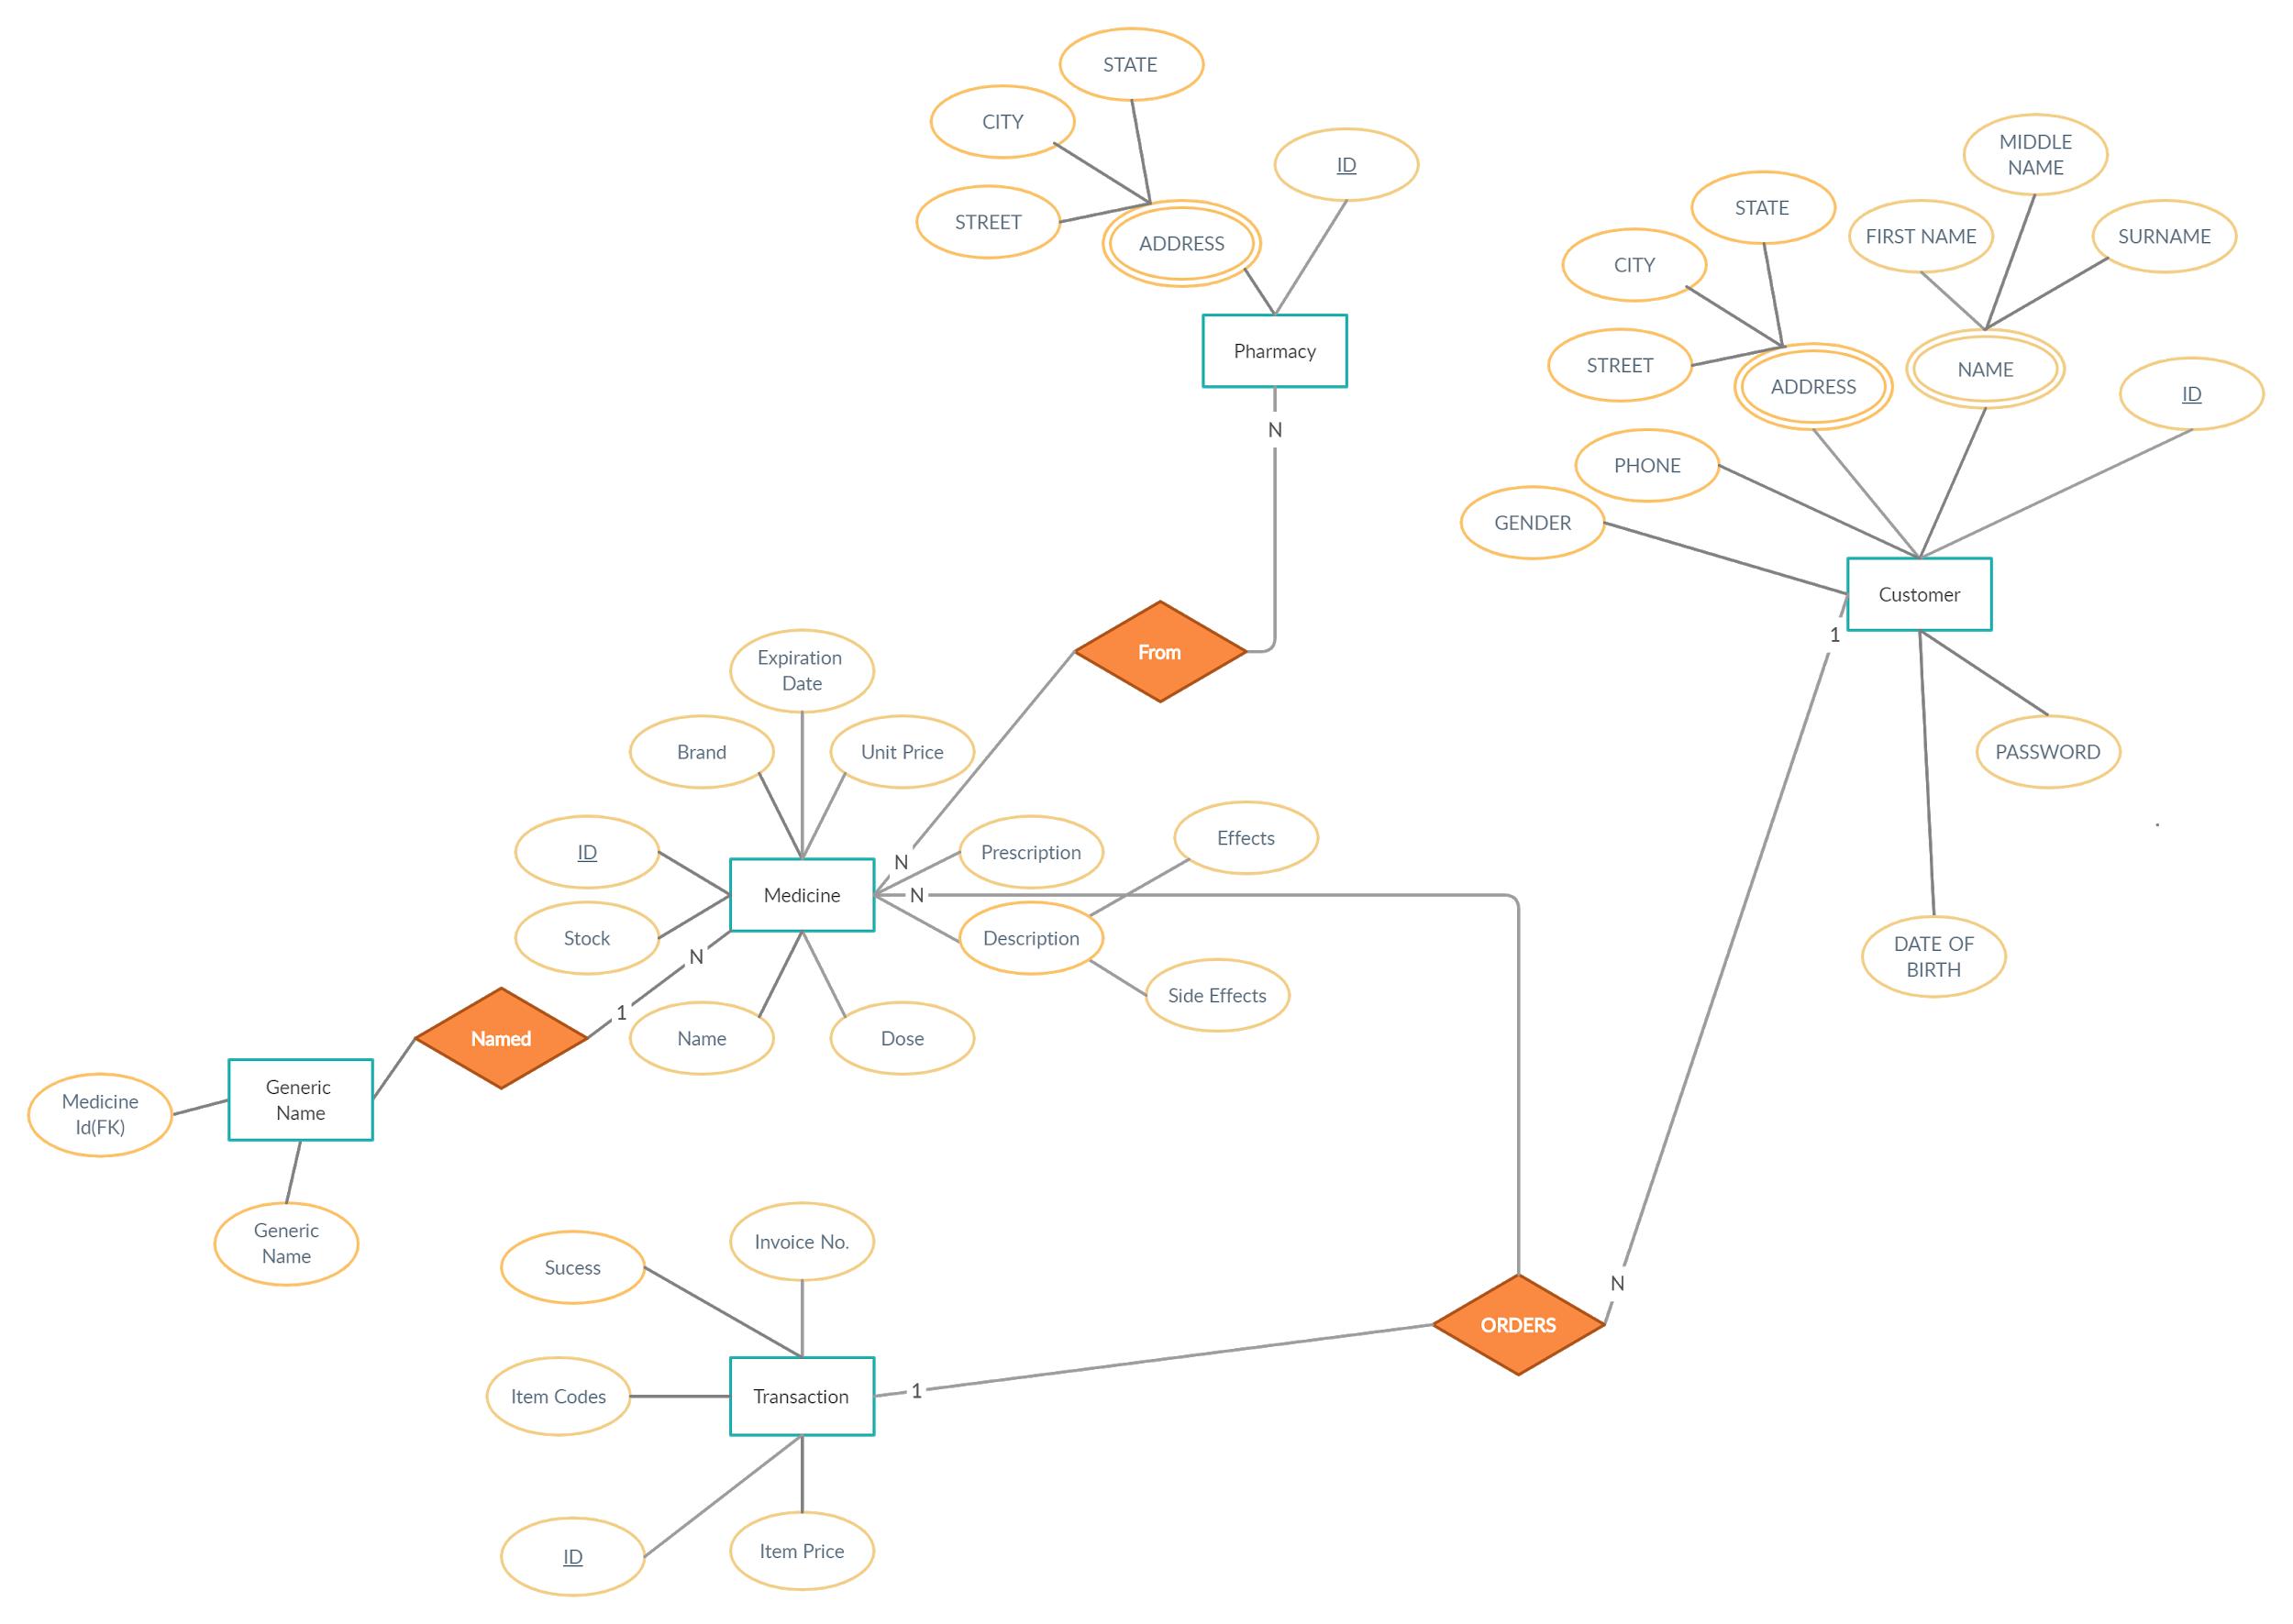
ER Diagram

Slide 4



Main Tables
Customer
Pharmacy
Medicine
Transaction
User ID, password and all other personal details like address, phone number etc.
Pharmacy ID, Pharmacy Name, and other details like address
Medicine ID, Name, Dosage, Effect, Side-Effects, and other details like Exp Date and generic name
Transaction ID, Customer ID, Item Code, and whether the transaction was successful or failed

Slide 5
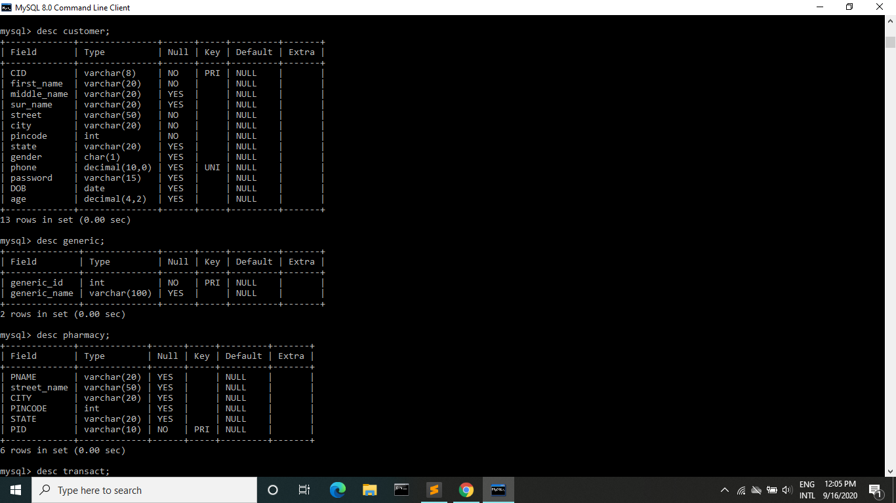
Customer Table
create table customer (
CID varchar(8) PRIMARY KEY check(CID like 'C%'),
first_name varchar(20) not null,
middle_name varchar(20),
sur_name varchar(20),
street varchar(20) not null,
city varchar(20) not null,
pincode int not null,
state varchar(20),
gender char(1) check( gender in ('M', 'F', 'O')),
phone decimal(10, 0) unique,
password varchar(15),
DOB date,
age decimal(4, 2)
);

Slide 6
Generic Table
Pharmacy Table
CREATE TABLE generic(
generic_id INT PRIMARY KEY,
generic_name VARCHAR(100)
);
CREATE TABLE pharmacy (
PNAME VARCHAR(20),
STREET_NAME varchar(50),
CITY varchar(20),
PINCODE int,
STATE varchar(20),
PID varchar(10) PRIMARY KEY
);

Slide 7
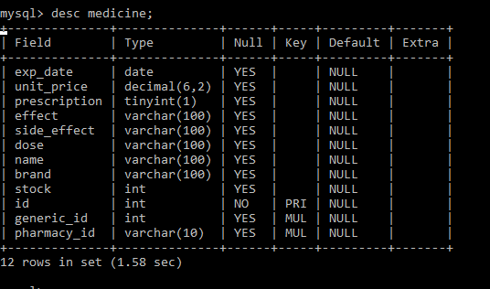
Medicine Table
CREATE TABLE medicine(
exp_date DATE,
unit_price DECIMAL(6, 2),
prescription TINYINT(1),
effect VARCHAR(100),
side_effect VARCHAR(100),
dose VARCHAR(100),
name VARCHAR(100),
brand VARCHAR(100),
stock INT,
id INT PRIMARY KEY,
generic_id INT,
pharmacy_id varchar(10),
FOREIGN KEY(generic_id) REFERENCES generic(generic_id),
FOREIGN KEY(pharmacy_id) REFERENCES pharmacy(PID)
);

Slide 8
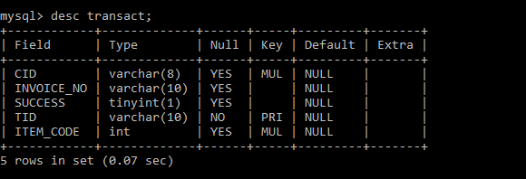
Transaction Table
CREATE TABLE transact(
CID varchar(8),
INVOICE_NO VARCHAR(10),
SUCCESS TINYINT(1),
TID varchar(10) PRIMARY KEY,
ITEM_CODE INT,
FOREIGN KEY(ITEM_CODE) REFERENCES medicine(id),
FOREIGN KEY(CID) REFERENCES customer(CID)
);

Slide 9
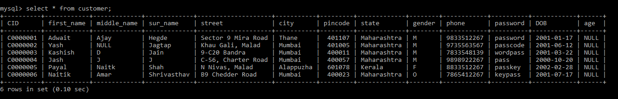
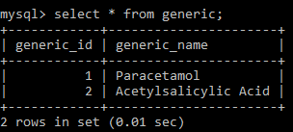
Customer Table
Generic Table

Slide 10
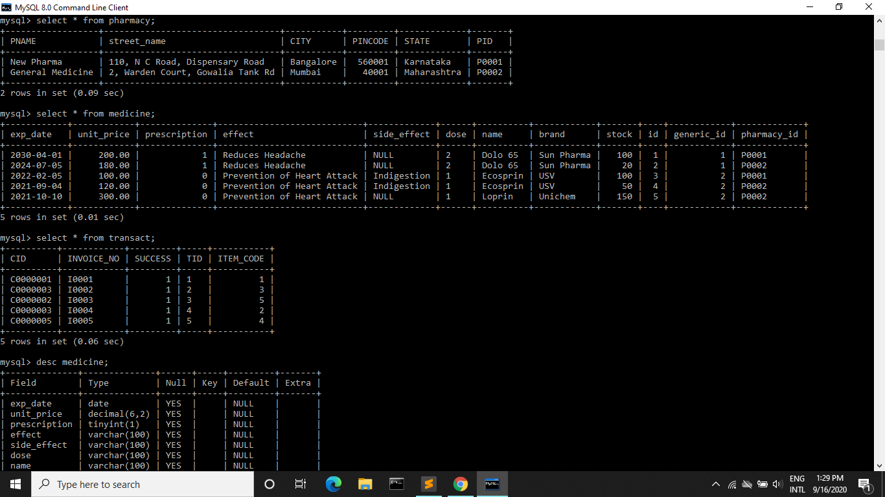
Pharmacy Table
Medicine Table

Slide 11
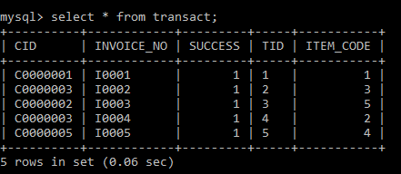
Transaction Table

Slide 12
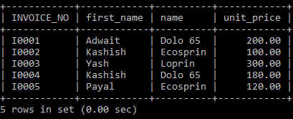
Query
SELECT
INVOICE_NO,
customer.first_name,
medicine.name,
medicine.unit_price
FROM transact
JOIN medicine
ON transact.ITEM_CODE = medicine.id
JOIN customer
ON transact.CID = customer.CID;

Slide 13

Thank you!

